Slide 1
Internet Control Message Protocol (ICMP)
A short module on the Internet Control Message Protocol (ICMP).

Slide 2
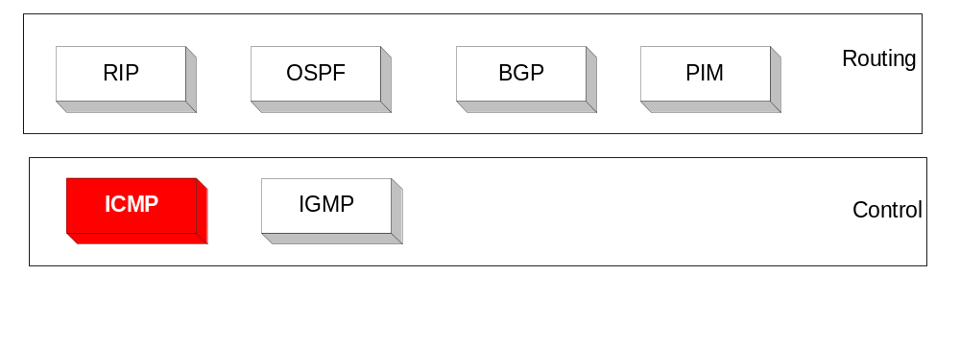
Overview
The IP (Internet Protocol) relies on several other protocols to perform necessary control and routing functions:
    Control functions (ICMP)
    Multicast signaling (IGMP)
    Setting up routing tables (RIP, OSPF, BGP, PIM, …)

Slide 3
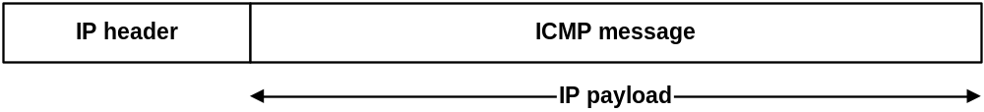
Overview
The Internet Control Message Protocol (ICMP) is a helper protocol that supports IP with facility for
  Error reporting
  Simple queries
ICMP messages are encapsulated as IP datagrams:

Slide 4
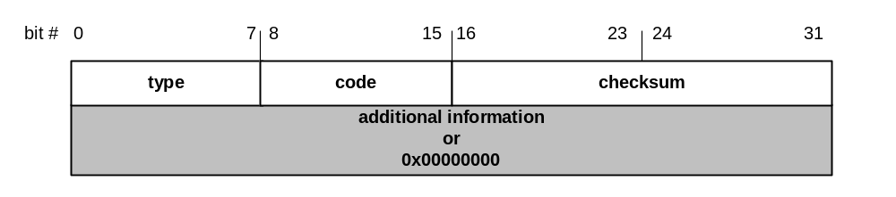
ICMP message format
4 byte header:
Type (1 byte): type of ICMP message
Code (1 byte): subtype of ICMP message
Checksum (2 bytes): similar to IP header checksum. Checksum is calculated over entire ICMP message
If there is no additional data, there are 4 bytes set to zero.
→ each ICMP messages is at least 8 bytes long

Slide 5
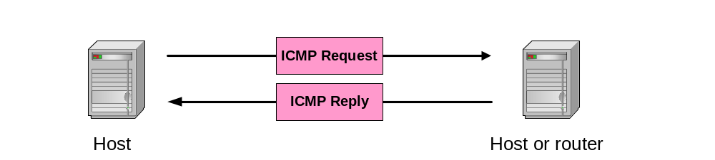
ICMP Query message
ICMP query:
Request sent by host to a router or host
Reply sent back to querying host

Slide 6
Example of ICMP Queries
Type/Code: Description
8/0 Echo Request
0/0 Echo Reply
13/0 Timestamp Request
14/0 Timestamp Reply
10/0 Router Solicitation
9/0 Router Advertisement
The ping command
uses Echo Request/
Echo Reply

Slide 7
Example of a Query:
Echo Request and Reply
Ping’s are handled directly by the kernel
Each Ping is translated into an ICMP Echo Request
The Ping’ed host responds with an ICMP Echo Reply
Host
or
Router
Host
or
router
ICMP ECHO REQUEST
ICMP ECHO REPLY

Slide 8
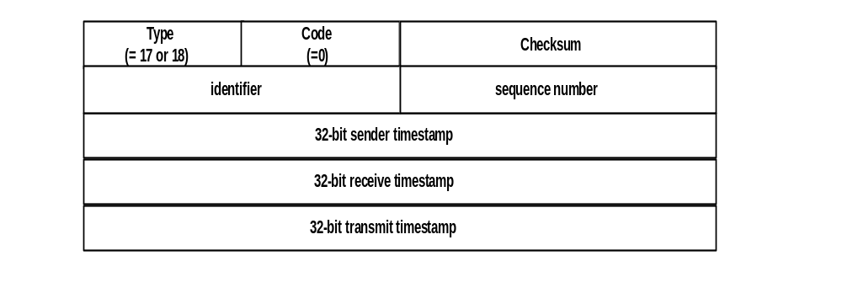
Example of a Query:
ICMP Timestamp
A system (host or router) asks another system for the current time.
Time is measured in milliseconds after midnight UTC (Universal Coordinated Time) of the current day
Sender sends a request, receiver responds with reply
Sender
Timestamp
Request
Receiver
Timestamp
Reply

Slide 9
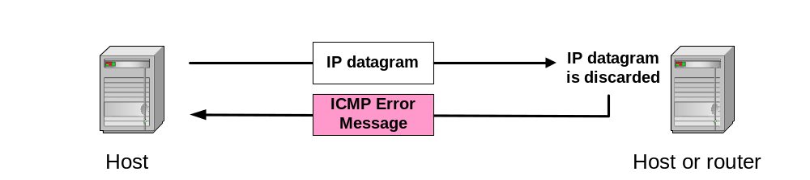
ICMP Error message
ICMP error messages report error conditions
Typically sent when a datagram is discarded
Error message is often passed from ICMP to the application program

Slide 10
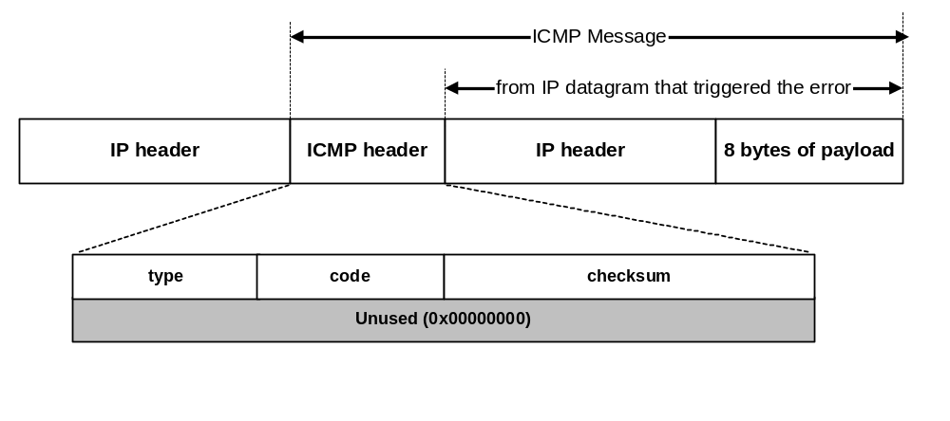
ICMP Error message
ICMP error messages include the complete IP header and the first 8 bytes of the payload (typically: UDP, TCP)

Slide 11
Frequent ICMP Error message
Type | Code | Description
3 | 0–15 | Destination unreachable | Notification that an IP datagram could not be forwarded and was dropped. The code field contains an explanation.
5 | 0–3 | Redirect | Informs about an alternative route for the datagram and should result in a routing table update. The code field explains the reason for the route change.
11 | 0, 1 | Time exceeded | Sent when the TTL field has reached zero (Code 0) or when there is a timeout for the reassembly of segments (Code 1)
12 | 0, 1 | Parameter problem | Sent when the IP header is invalid (Code 0) or when an IP header option is missing (Code 1)

Slide 12
Some subtypes of the “Destination Unreachable”
Code | Description | Reason for Sending
0 | Network Unreachable | No routing table entry is available for the destination network.
1 | Host Unreachable | Destination host should be directly reachable, but does not respond to ARP Requests.
2 | Protocol Unreachable | The protocol in the protocol field of the IP header is not supported at the destination.
3 | Port Unreachable | The transport protocol at the destination host cannot pass the datagram to an application.
4 | Fragmentation Needed and DF Bit Set | IP datagram must be fragmented, but the DF bit in the IP header is set.

Slide 13
Example: ICMP Port Unreachable
RFC 792: If, in the destination host, the IP module cannot deliver the datagram because the indicated protocol module or process port is not active, the destination host may send a destination unreachable message to the source host.
Scenario:
Request a service
at a port 80
Client
Server
No process is waiting at port 80
Port
Unreachable

